Slide 1

Oracle 12c: SQL
Chapter 6
Additional Database Objects
©2016. Cengage Learning. All rights reserved.

Slide 2
Objectives
Define the purpose of a sequence and state how it can be used in a database
Explain why gaps may appear in the integers generated by a sequence
Use the CREATE SEQUENCE command to create a sequence
Call and use sequence values
Identify which options cannot be changed by the ALTER SEQUENCE command
Delete a sequence
©2016. Cengage Learning. All rights reserved.

Slide 3
Objectives (continued)
Create indexes with the CREATE INDEX command
Explain the main index structures: B-tree and bitmap
Verify index use with the explain plan
Introduce variations on conventional indexes, including a function-based index and an index organized table
©2016. Cengage Learning. All rights reserved.

Slide 4
Objectives (continued)
Verify index existence via the data dictionary
Rename an index with the ALTER INDEX command
Remove an index using the DELETE INDEX command
Create and remove a public synonym
©2016. Cengage Learning. All rights reserved.

Slide 5
Database Objects
An object is anything that has a name and defined structure
Includes:
  Table – stores data
  Sequence – generates sequential integers
  Index – allows users to quickly locate specific records
  Synonym – alias for other database objects
©2016. Cengage Learning. All rights reserved.

Slide 6
Sequences
Used for internal control purposes by providing sequential integers for auditing
Used to generate unique value for primary key column
  Surrogate key = no correlation with actual row contents
©2016. Cengage Learning. All rights reserved.

Slide 7
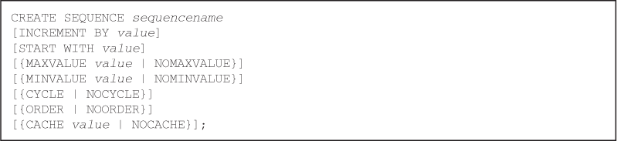
Creating a Sequence
Use the CREATE SEQUENCE command
Various intervals are allowed – Default: 1
You can specify the starting number – Default: 1
©2016. Cengage Learning. All rights reserved.

Slide 8
Creating a Sequence (continued)
Can specify MINVALUE for decreasing sequence and MAXVALUE for increasing sequence
Numbers can be reused if CYCLE is specified
ORDER clause is used in application cluster environment
Use CACHE to pregenerate integers – Default: 20
©2016. Cengage Learning. All rights reserved.

Slide 9
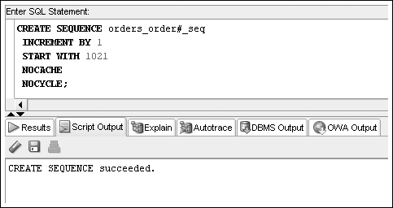
Creating a Sequence (continued)
©2016. Cengage Learning. All rights reserved.

Slide 10
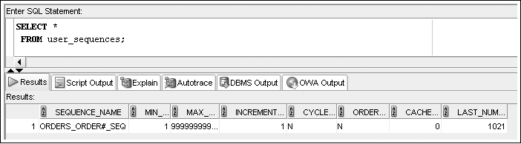
Creating a Sequence (continued)
To verify the settings for options of a sequence, query USER_SEQUENCES data dictionary view
Next Number to issue
©2016. Cengage Learning. All rights reserved.

Slide 11
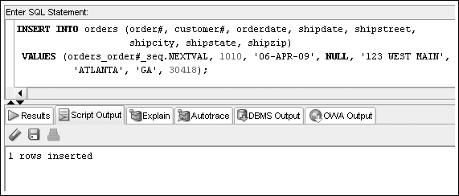
Using Sequence Values
NEXTVAL – generates integer
©2016. Cengage Learning. All rights reserved.

Slide 12
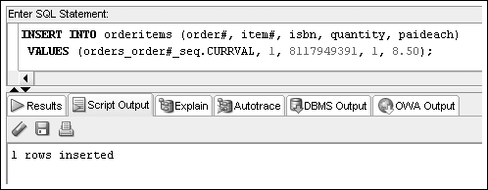
Using Sequence Values (continued)
CURRVAL – contains last integer generated by NEXTVAL
©2016. Cengage Learning. All rights reserved.

Slide 13
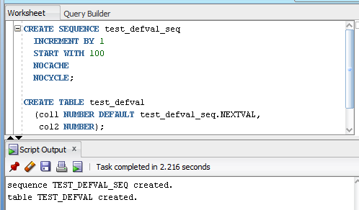
Using Sequence Values (continued)
Set column DEFAULT value
©2016. Cengage Learning. All rights reserved.

Slide 14
Altering Sequence Definitions
Use ALTER SEQUENCE command to change the settings for a sequence
START WITH value cannot be altered – drop the sequence and re-create it
Changes cannot make current integers invalid
©2016. Cengage Learning. All rights reserved.

Slide 15
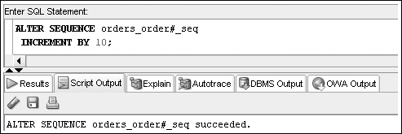
ALTER SEQUENCE Command Example
©2016. Cengage Learning. All rights reserved.

Slide 16
Removing a Sequence
Use the DROP SEQUENCE command to delete a sequence
Previous values generated are not affected by removing a sequence from a database
©2016. Cengage Learning. All rights reserved.

Slide 17
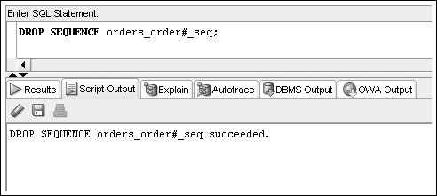
Removing a Sequence (continued)
©2016. Cengage Learning. All rights reserved.

Slide 18
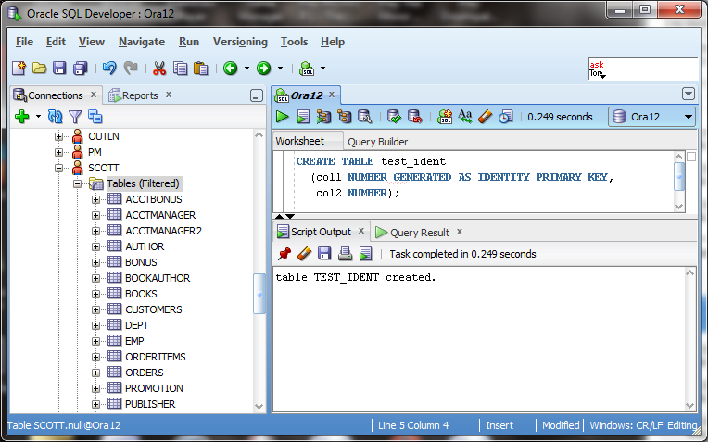
Create an Identity Column
Alternative to using sequences to populate primary key columns
©2016. Cengage Learning. All rights reserved.

Slide 19
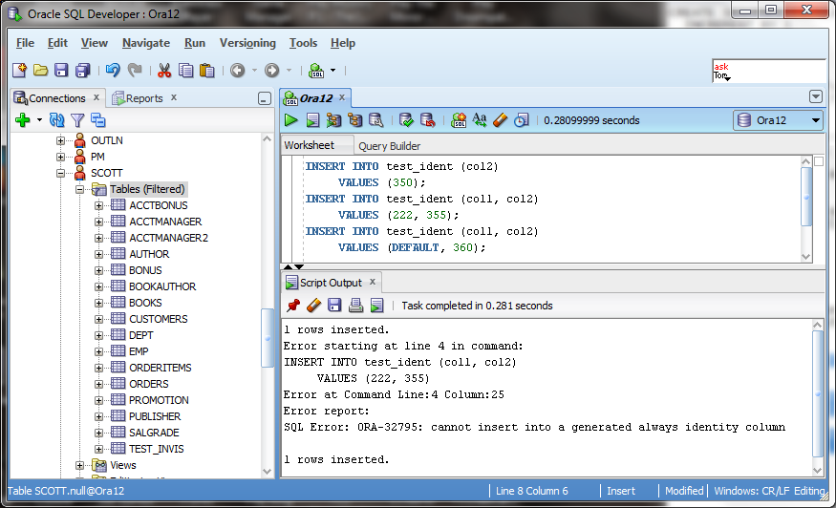
Using an Identity Column
©2016. Cengage Learning. All rights reserved.

Slide 20
Indexes
An index stores frequently referenced values and ROWIDs
Can be based on one column, multiple columns, functions, or expressions
©2016. Cengage Learning. All rights reserved.

Slide 21
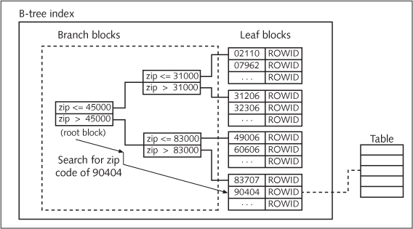
B-Tree Index
©2016. Cengage Learning. All rights reserved.

Slide 22
B-Tree Index (continued)
Implicitly create an index by PRIMARY KEY and UNIQUE constraints
Explicitly create an index by using the CREATE INDEX command
©2016. Cengage Learning. All rights reserved.

Slide 23
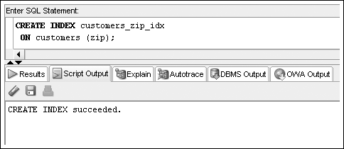
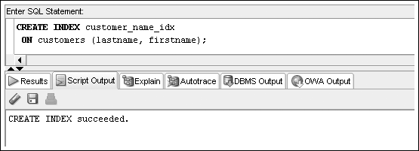
CREATE INDEX Command Examples
©2016. Cengage Learning. All rights reserved.

Slide 24
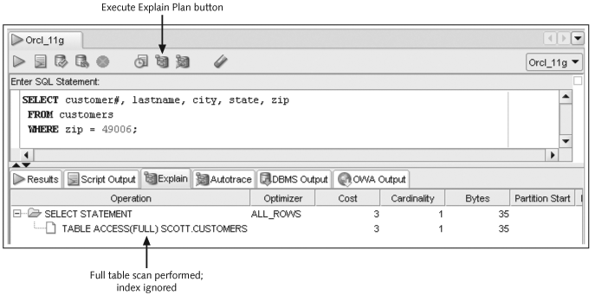
The Explain Plan
©2016. Cengage Learning. All rights reserved.

Slide 25
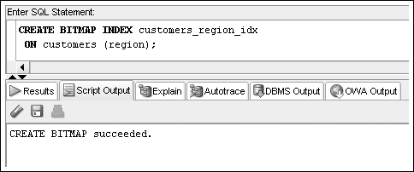
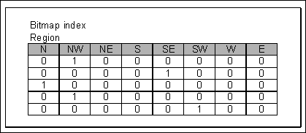
Bitmap Indexes
©2016. Cengage Learning. All rights reserved.

Slide 26
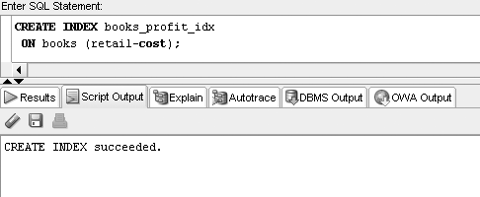
Function-Based Indexes
©2016. Cengage Learning. All rights reserved.

Slide 27
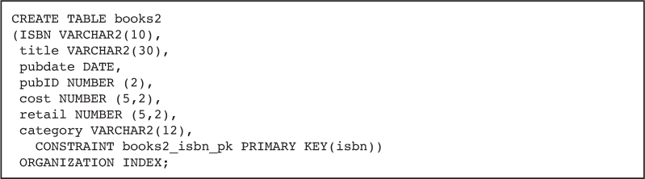
Index Organized Tables
An IOT stores table contents in a B-tree index structure
Use the “ORGANIZATION INDEX” option in a CREATE TABLE statement to build an IOT
©2016. Cengage Learning. All rights reserved.

Slide 28
Verifying an Index
Use the USER_INDEXES data dictionary view to determine that the index exists
Use the USER_IND_COLUMNS data dictionary view to determine the column index information
©2016. Cengage Learning. All rights reserved.

Slide 29
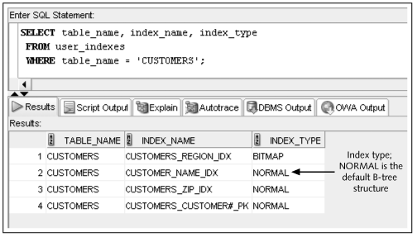
Verifying an Index (continued)
©2016. Cengage Learning. All rights reserved.

Slide 30
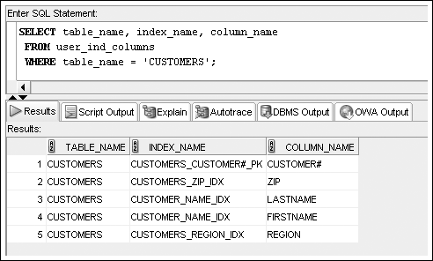
USER_IND_COLUMNS
©2016. Cengage Learning. All rights reserved.

Slide 31
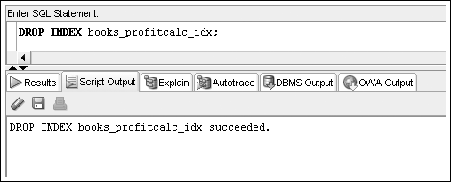
Removing an Index
Use the DROP INDEX command to remove an index
©2016. Cengage Learning. All rights reserved.

Slide 32
Synonyms
Synonyms serve as permanent aliases for database objects
Simplify object references
Can be private or public
  Private synonyms are only available to the user who created them
  PUBLIC synonyms are available to all database users
©2016. Cengage Learning. All rights reserved.

Slide 33
CREATE SYNONYM Command Syntax
©2016. Cengage Learning. All rights reserved.

Slide 34
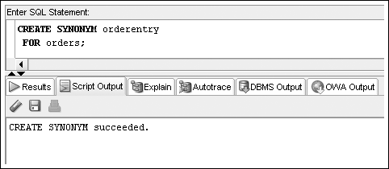
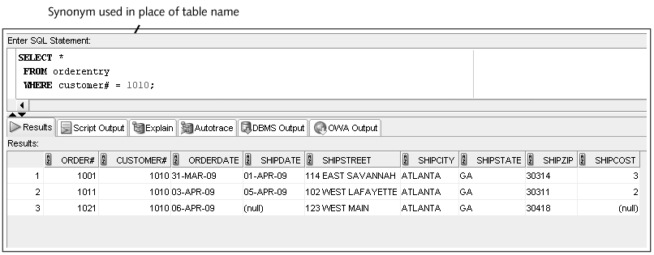
CREATE SYNONYM Command
©2016. Cengage Learning. All rights reserved.

Slide 35
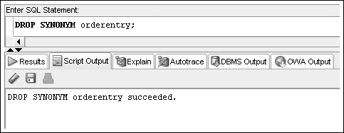
Deleting a SYNONYM
A private synonym can be deleted by its owner
A PUBLIC synonym can only be deleted by a user with DBA privileges
©2016. Cengage Learning. All rights reserved.

Slide 36
Summary
A sequence can be created to generate a series of integers
The values generated by a sequence can be stored in any table
A sequence is created with the CREATE SEQUENCE command
Gaps in sequences might occur if the values are stored in various tables, if numbers are cached but not used, or if a rollback occurs
A value is generated by using the NEXTVAL pseudocolumn
The CURRVAL pseudocolumn is NULL until a value is generated by NEXTVAL
The USER_OBJECTS data dictionary object can be used to confirm the existence of all schema objects
The USER_SEQUENCES data dictionary object is used to view sequence settings
A sequence may be set as a column DEFAULT value
An identity column can be created to manage primary key population as an alternative to using sequences
©2016. Cengage Learning. All rights reserved.

Slide 37
Summary (continued)
The ALTER SEQUENCE command is used to modify an existing sequence; the only settings that can’t be modified are the START WITH option and any option that would be invalid because of previously generated values
The DUAL table is helpful for testing sequence value generation
The DROP SEQUENCE command deletes an existing sequence
An index can be created to speed up the query process
DML operations are always slower when indexes exist
Oracle 11g creates an index for PRIMARY KEY and UNIQUE constraints automatically
An explicit index is created with the CREATE INDEX command
An index can be used by Oracle 11g automatically if a query criterion or sort operation is based on a column or an expression used to create the index
©2016. Cengage Learning. All rights reserved.

Slide 38
Summary (continued)
The two main structures for indexes are B-tree and bitmap
The explain plan can verify whether an index is used in a query
Function-based indexes are used to index an expression or the use of functions on a column or columns
An index organized table is a table stored in a B-tree structure to combine the index and table into one database object
Information about an index can be retrieved from the USER_INDEXES and USER_IND_COLUMNS views
An index can be dropped with the DROP INDEX command
An index can be renamed with the ALTER INDEX command
©2016. Cengage Learning. All rights reserved.

Slide 39
Summary (continued)
Except for a name change, an index can’t be modified; it must be deleted and then re-created
A synonym provides a permanent alias for a database object
A public synonym is available to any database user
A private synonym is available only to the user who created it
A synonym is created by using the CREATE SYNONYM command
A synonym is deleted by using the DROP SYNONYM command
Only a user with DBA privileges can drop a public synonym
©2016. Cengage Learning. All rights reserved.

